Slide 1
Hello!
Theodore Kim
Public Speaking – Introductory Speech

Slide 2
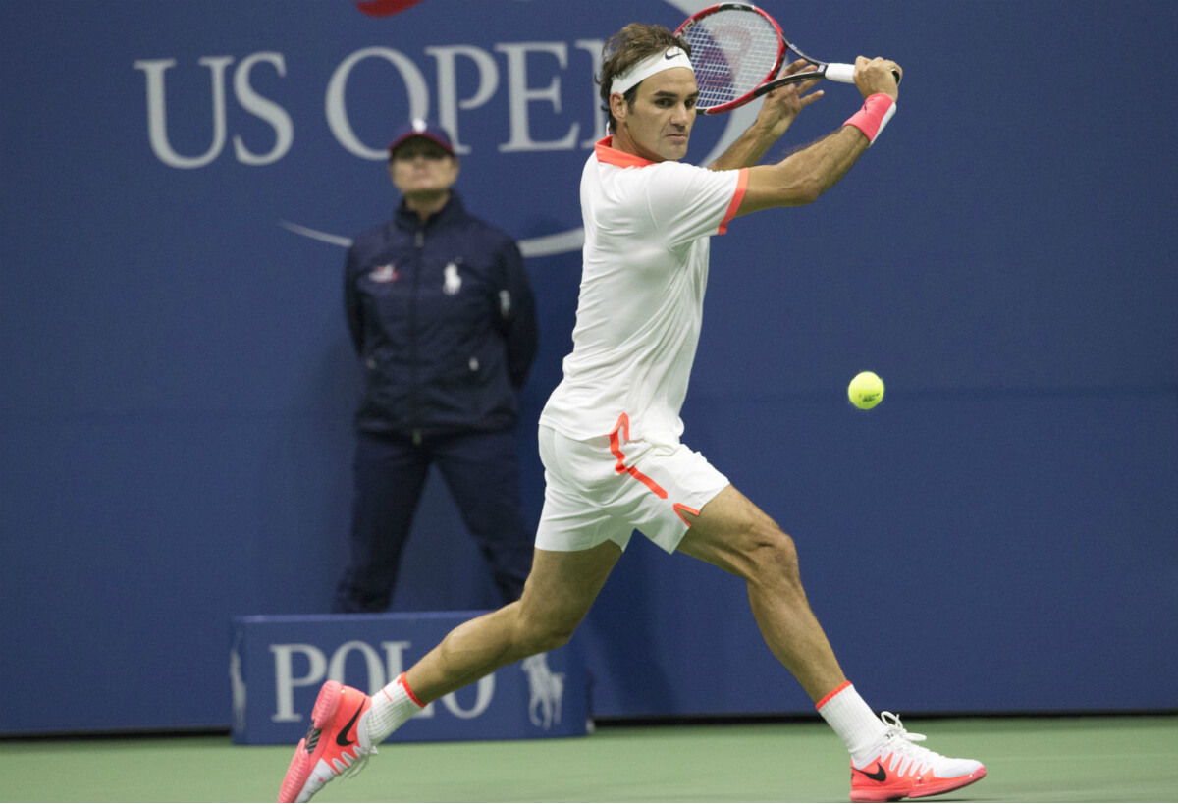
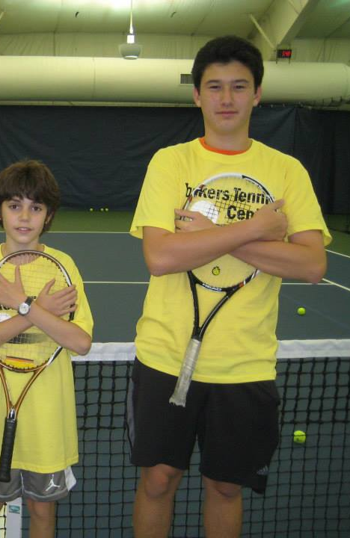

Slide 4
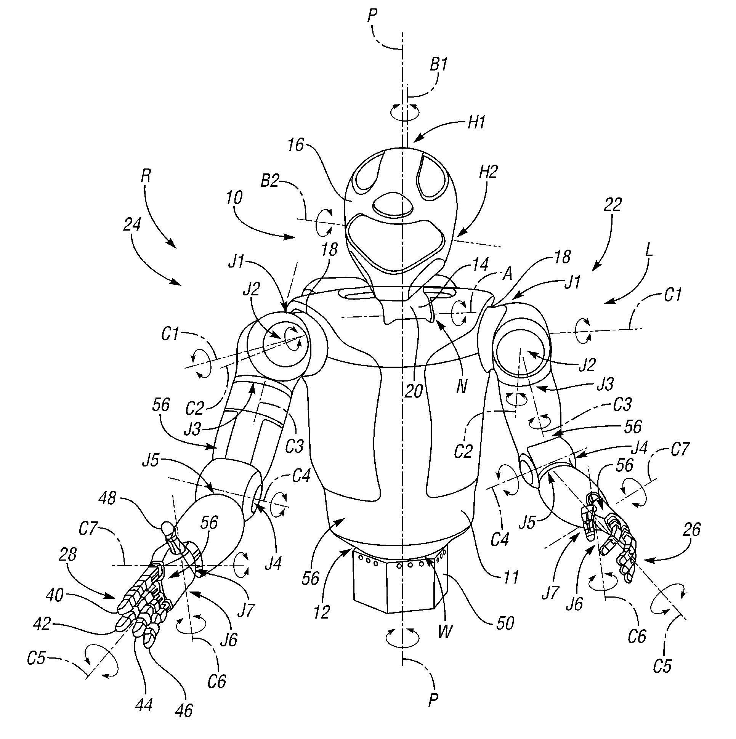

Slide 5
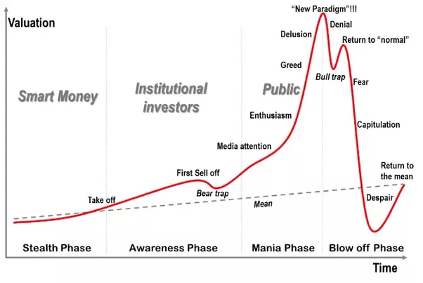

Slide 8
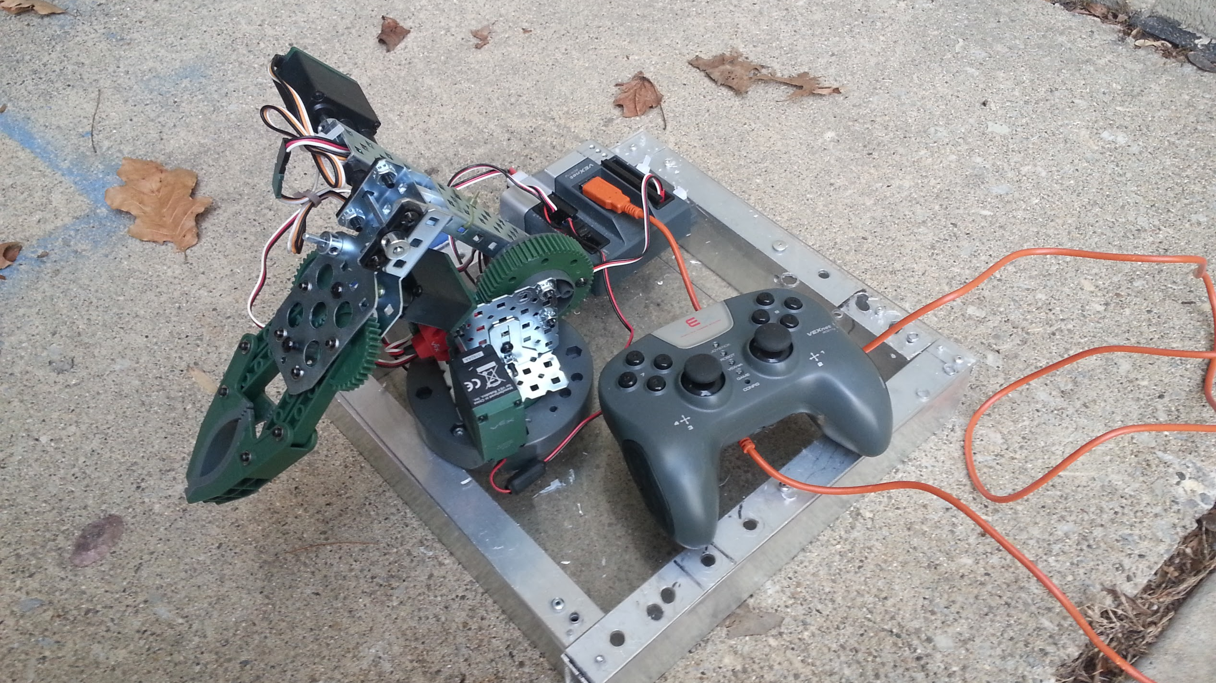

Slide 9
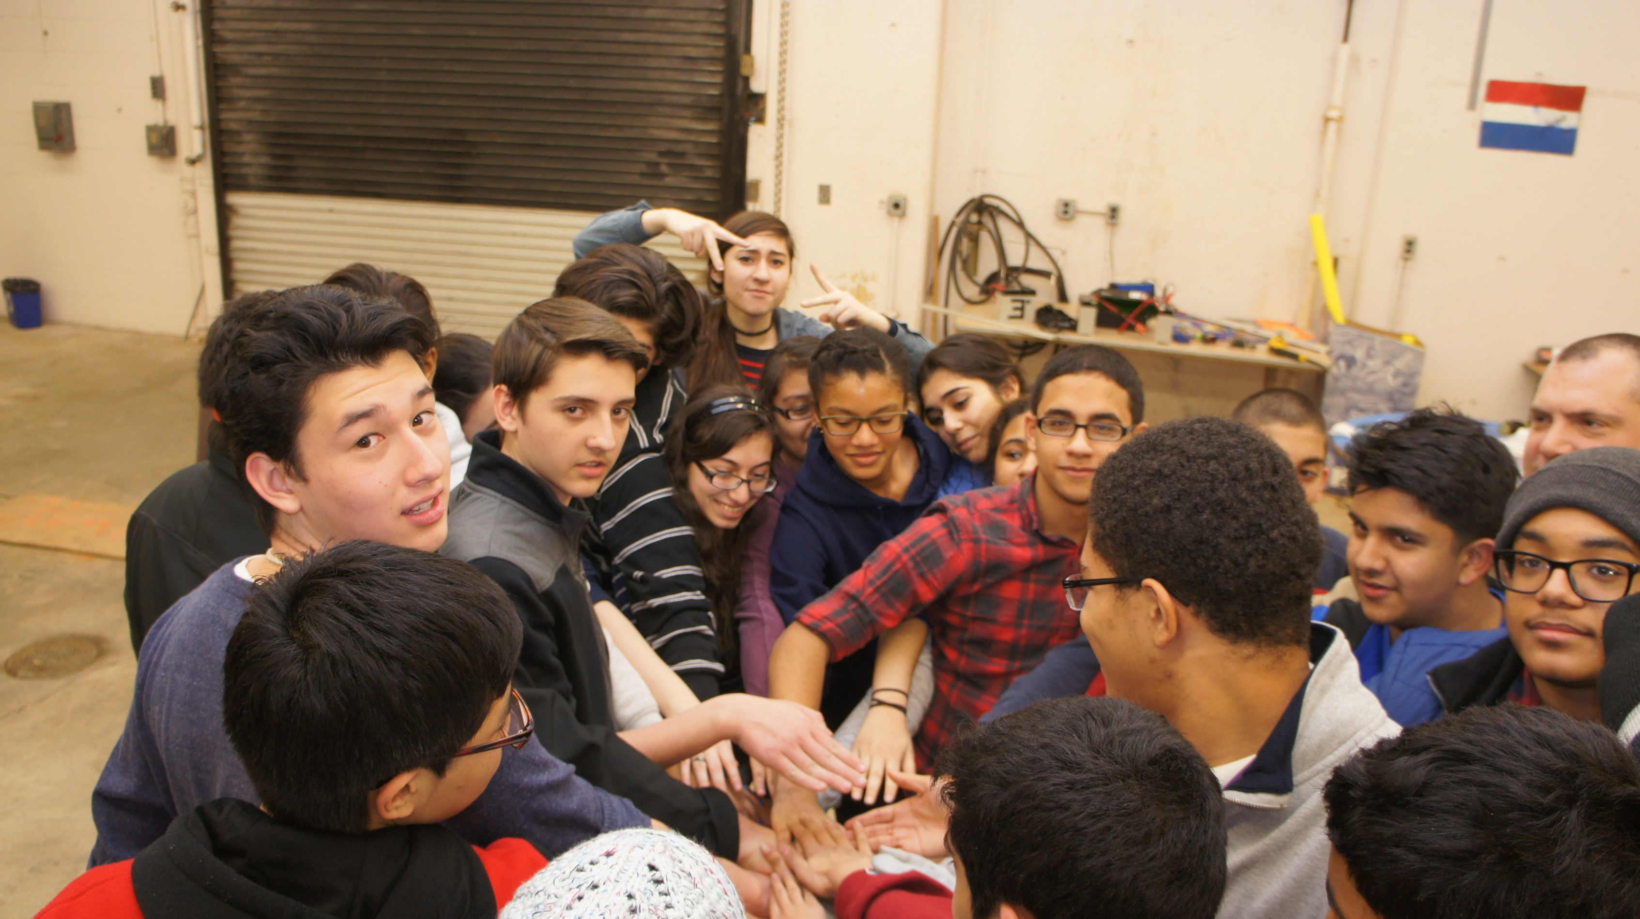

Slide 10


Slide 11
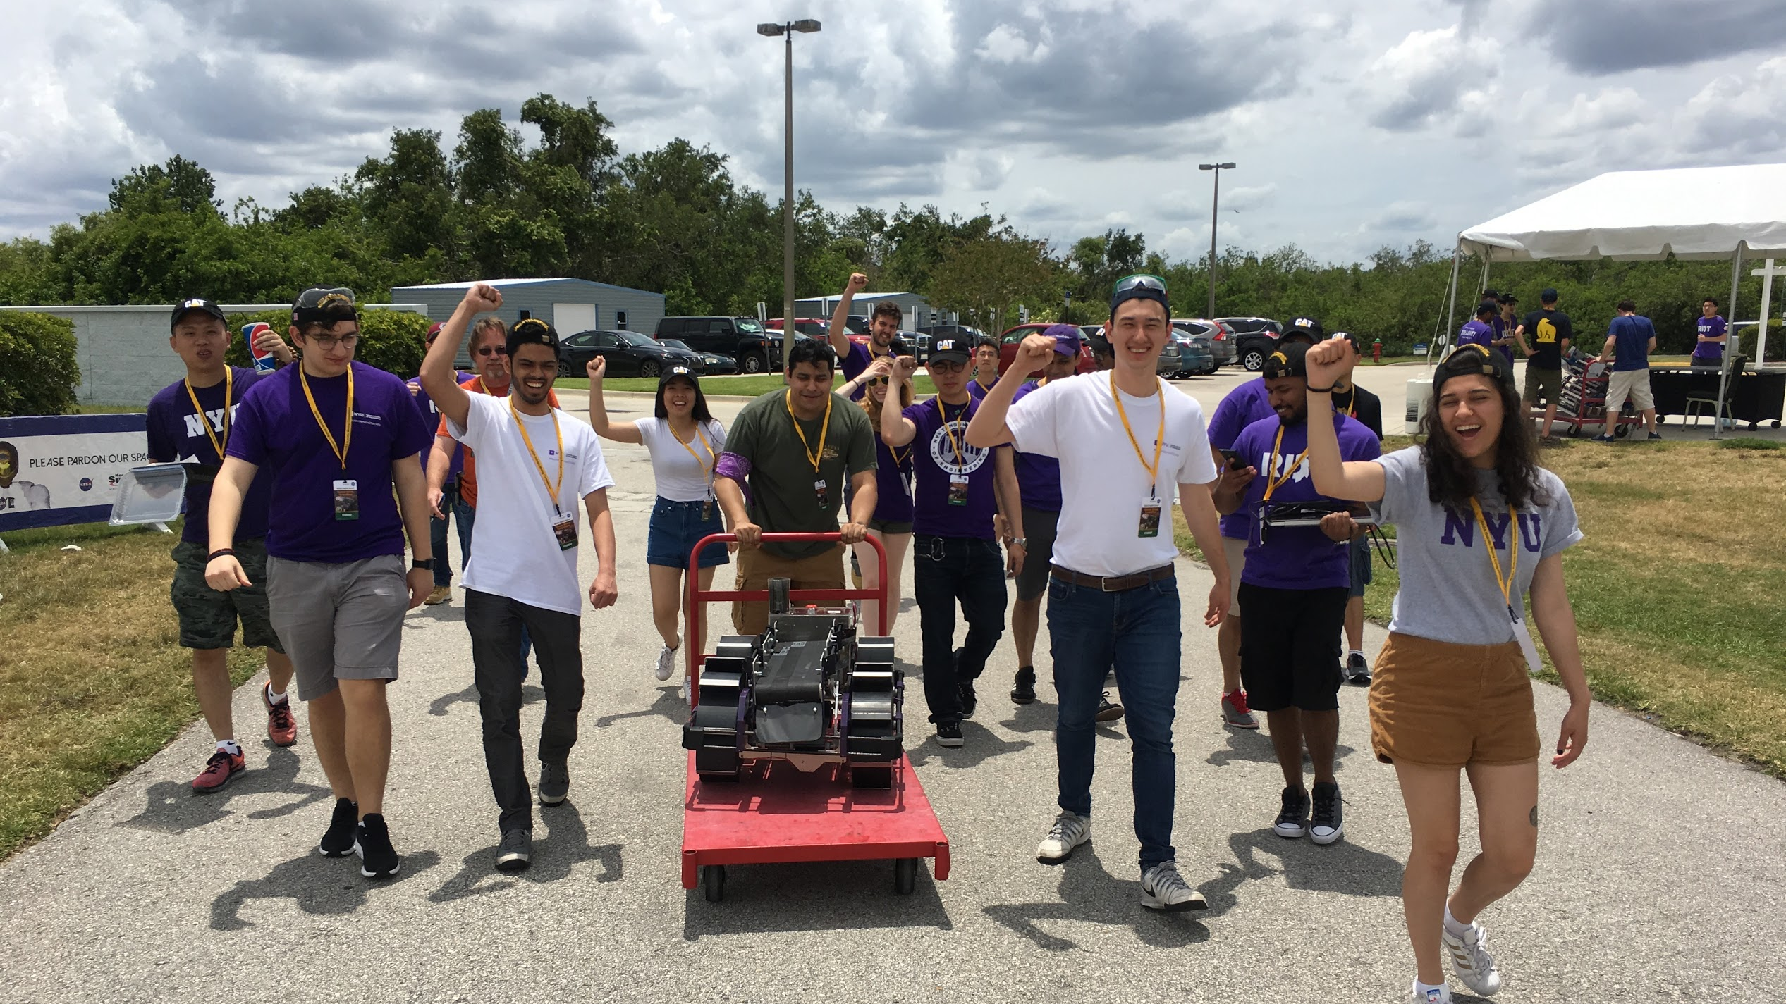

Slide 12


Slide 13
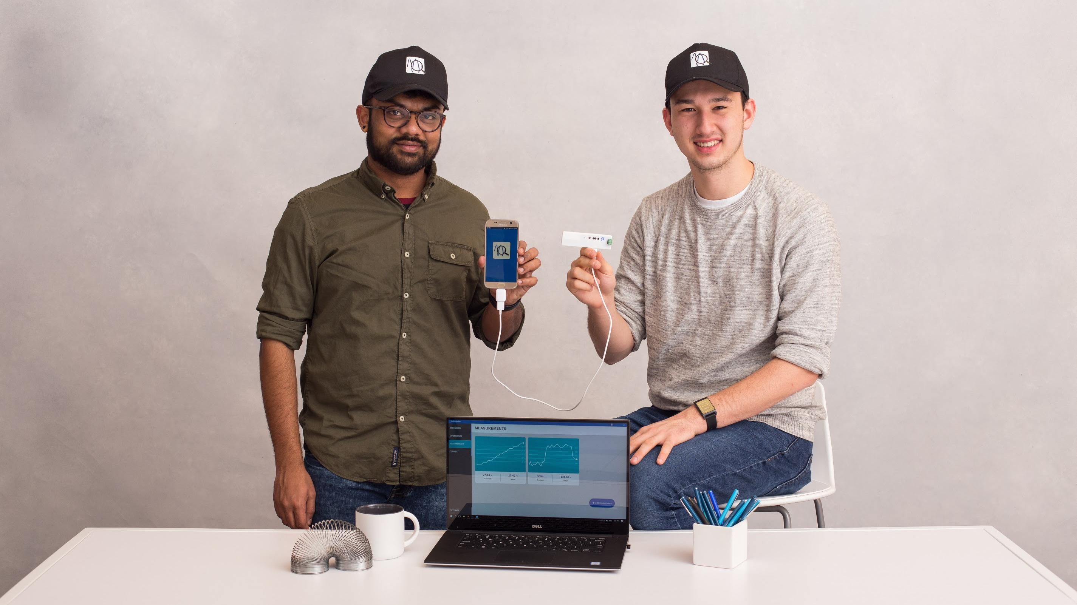

Slide 14


Slide 15
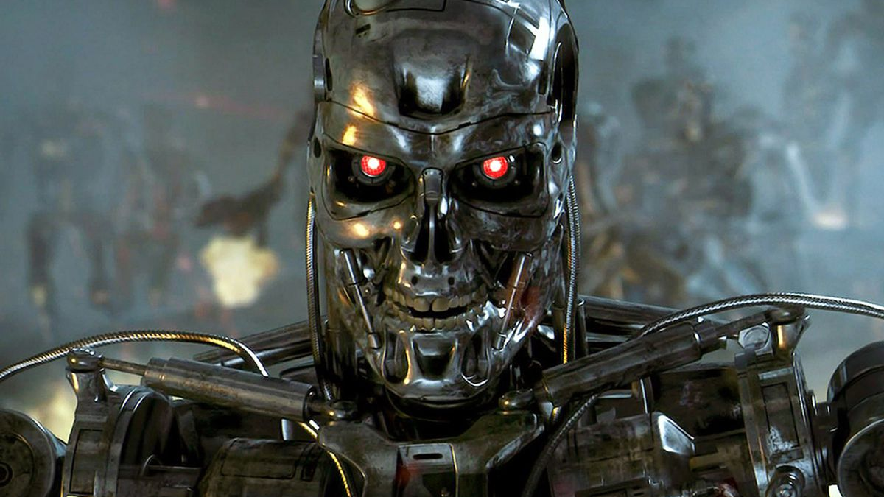

Slide 16
Thanks!
Theodore Kim
Public Speaking – Introductory Speech

